Slide 1



The Reading List Challenge: Implementing the Loughborough
Online Reading List System (LORLS)
Gary Brewerton
Middleware & Library Systems, Loughborough University
Marie O’ Neill
Head of Library Services, Dublin Business School

Slide 2
Content
What is a Reading List?
  How they vary and what are the issues with them
Developing a solution
  What we did at Loughborough
Sharing our solution
  Can bring benefits to all
Implementing at Dublin Business School

Slide 3
What is a Reading List?
A list of resources (books, journals, AV material, websites, etc.) compiled by an academic to support students in their studies
  Available in print, electronically or both
  Typically organised alphabetically, chronologically, by subject or a combination of these
  May include annotations from the academic (e.g. stating why a given resource should be read)

Slide 4
Can vary dramatically in length!
Engineering
6
144
13
Science
190
Arts and Social
Sciences
63
1,479
Average length
Maximum length
Data generated December 2013 at Loughborough University

Slide 5
Issues with Reading Lists
Students struggle to locate resources on Reading Lists
Academics aren’t aware of how (or even if) their Reading Lists are being used
The Library can only provide access to resources it knows about
The institution’s reputation may suffer if Reading Lists aren’t doing their job!

Slide 6
Tackling the issues
Loughborough University’s Learning & Teaching Committee were keen to address these issues
  Library seen as central to providing a solution
  In 1999 a web-based system was conceived to:
    Allow academics to create and maintain online Reading Lists
    Alert Library staff to changes made to Reading Lists
    Enable students to browse and search for Reading Lists and link to related Library holdings

Slide 7
Developing a solution
2000
  Web-based system launched at Loughborough
2002
  Finally gave it a name: LORLS (Loughborough Online Reading List System)
  Made it available as open source after other institutions expressed interest in it
2007
  Decided to re-develop the system
2010-14
  Launch and ongoing development of latest versions

Slide 8
A brief view of LORLS

Slide 9
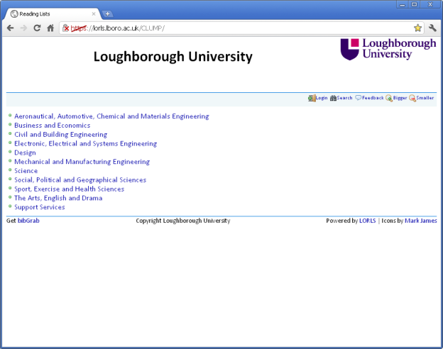
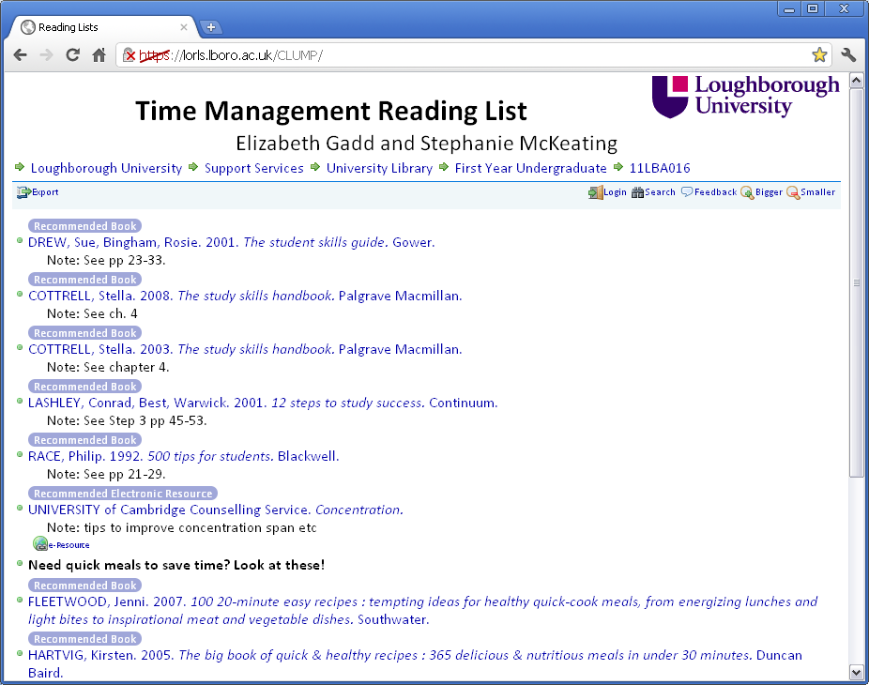
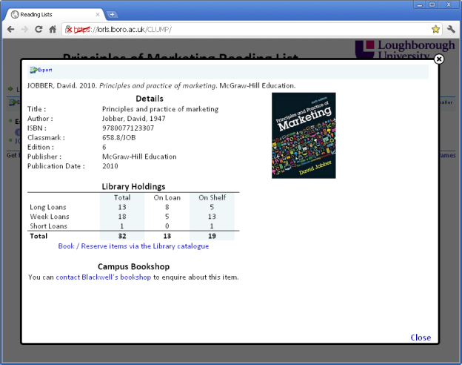
Student view of LORLS
Browse or search for Reading Lists
Standard citation format (Harvard UK)
Library holdings displayed
Book covers via GoogleBooks
Can like/dislike items

Slide 10
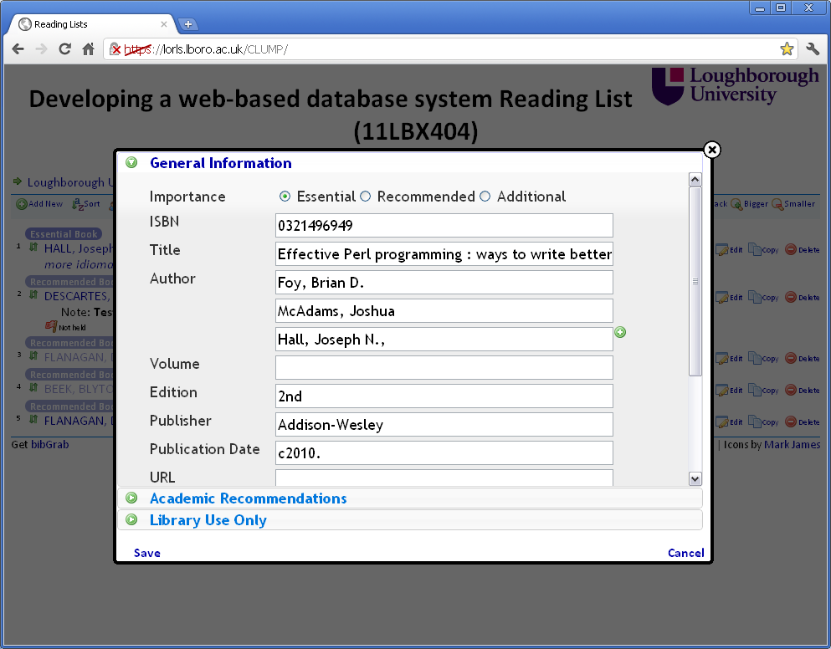
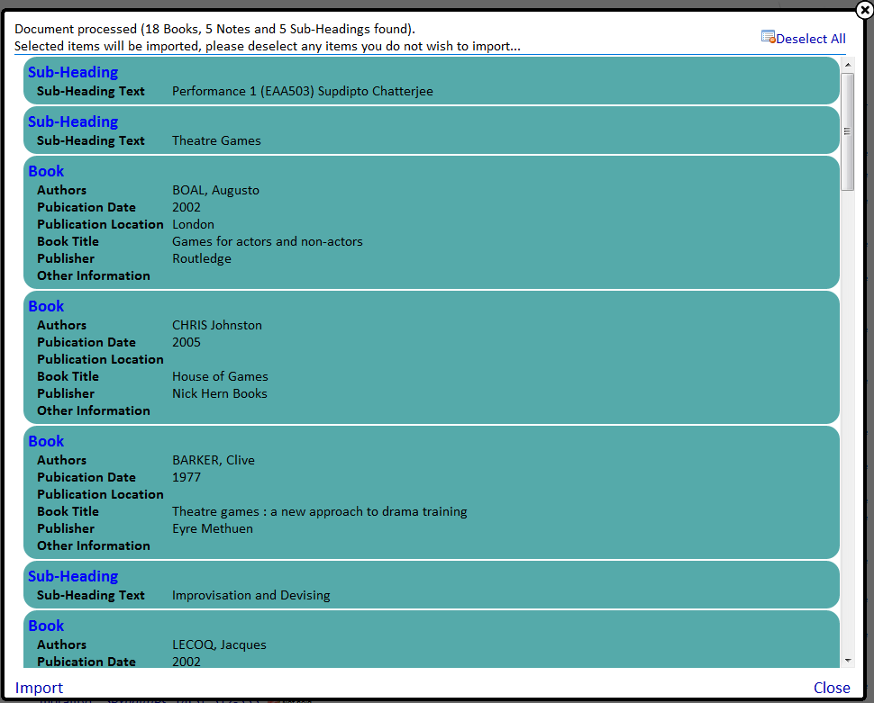
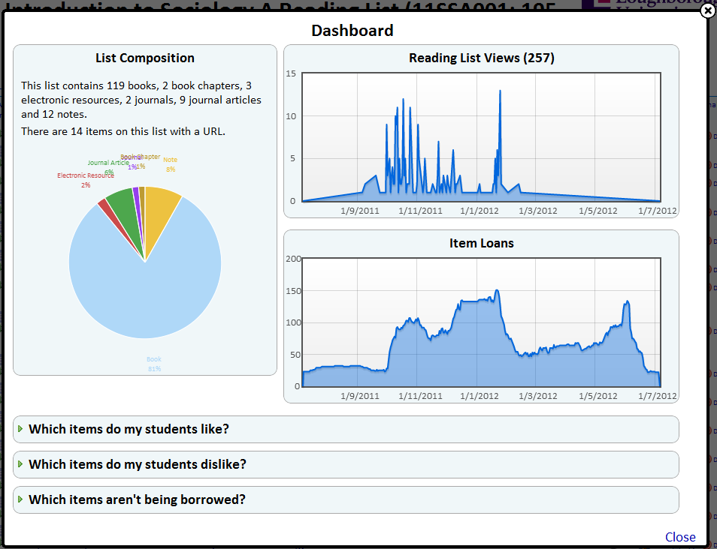
Academic view of LORLS
Input items manually, via ISBN/ISSN, from the web or by importing them
Hide, edit, copy or delete items
Sort and annotate Reading Lists as required
See how the Reading List is being used

Slide 11
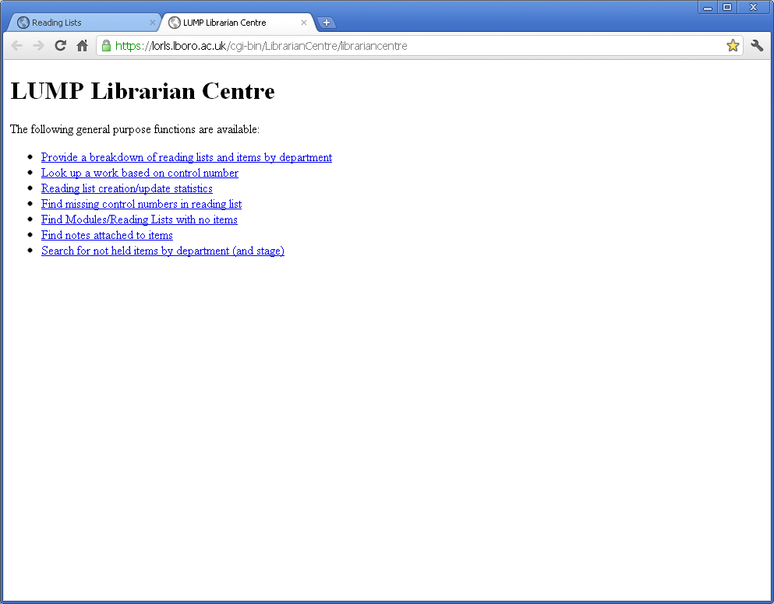
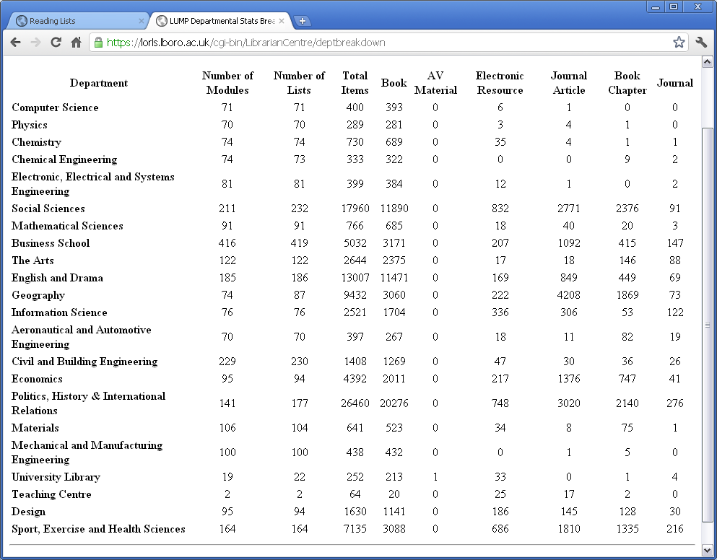
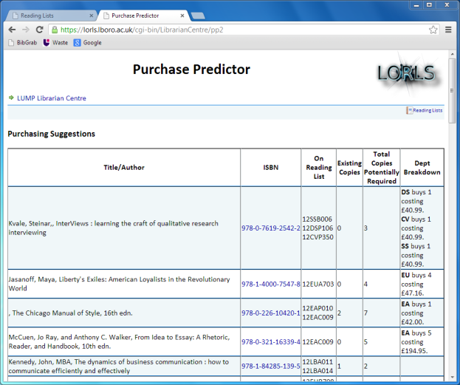
Library view of LORLS
Items flagged if not held or with private notes attached
Email Library staff with changes made to Reading Lists
Various online reports available (e.g. show all the Reading Lists an item is on)
Purchasing predictor to suggest items for acquisition (beta)

Slide 12
Sharing our solution
We maintain a website about LORLS (http://blog.lboro.ac.uk/lorls) including:
  Development diary
  Online demo
  Documentation
  Download source code under a GPL
Meeting the Reading List Challenge
  Host annual event that brings together librarians, developers and suppliers to discuss the issues around Reading Lists (http://blog.lboro.ac.uk/mtrlc)

Slide 13
Benefits of open source
There are many benefits to using open source (e.g. cost, flexibility, adherence to standards) but there are also benefits in providing open source
  Prestige (especially for the developers’ institution)
  Trip to Ireland to talk at Library seminar
  Gain valuable insight from other users to inform future developments

Slide 14
Working with DBS
We were approached in September 2013 about DBS using LORLS
  Great to work with another institution and our first one outside the UK
  Opportunity to integrate LORLS with the Koha open source Library Management System
  Received constructive and helpful feedback that will allow us to develop LORLS further

Slide 15
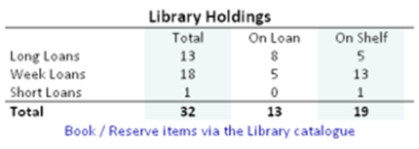
Example DBS feedback
Since 2010 LORLS has
shown Library holding
  It shows total number
  of copies held, those on
  loan and the remainder listed as “On shelf”
  But as DBS pointed out this could be misleading
    Copies “On shelf” may be reserved and therefore not available to students
    What about copies on order?
  We agree! So we’ll be taking a good look at the display of Library holdings in the coming months

Slide 16
So that’s the software sorted
(Other systems such as Rebus:list, Talis Aspire and Telstar are available )

Slide 17
Now comes the hard part!
Embedding into institutional workflows
  Who uploads/maintains the Reading Lists?
Advocacy
  Use every opportunity you can
  What works for one group may not work for another
Training and support
Keep monitoring progress with Reading Lists

