Slide 1
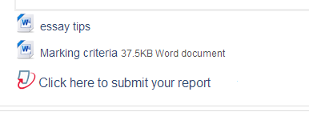
Submitting coursework through TurnItIn
Step 1: Find the assignment link, and click it
all TurnItIn assignments
have this icon
Centre for Academic Practice
Notes:
The assignment link will usually instruct you to click it in order to submit your work.

Slide 2
Step 2: Check the details
This is the
deadline
Marks and feedback
will be available from
the Post Date
You can’t submit anything
before the Start Date
Make sure
this is
the right
assignment!
Click ‘Submit Paper’ to
upload your coursework
Notes:
If it is a multi-part assignment, where you submit several files, each part (=file) has its own tab, with its own dates.
In this case, there is only one part, called ‘Report’.

Slide 3
Step 3: Drag and drop
Give your work a short title
(less than 40 characters)
Drag your file into the dashed box to
upload it to Learn.
Count to 10 and its icon will appear.
Nothing is submitted until
you click this button

Slide 4
Every submission needs: a title the file itself, and a tick in the agreement box
If the Add Submission button has been pushed
off the screen, scroll down to find it

Slide 5
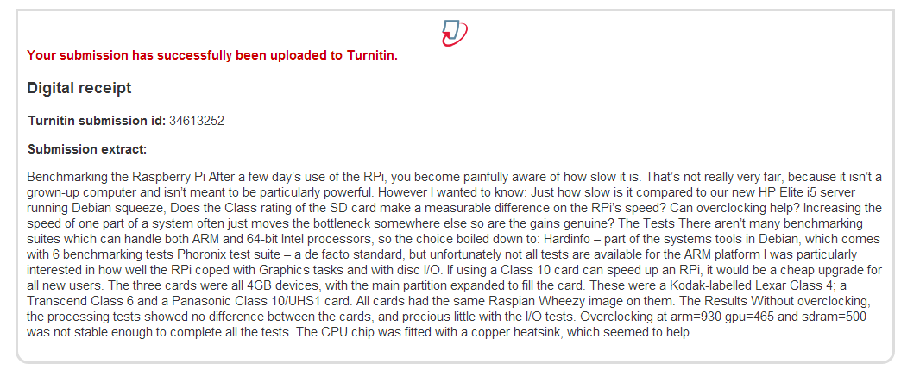
When you Close the drop-box, the file is sent from Learn to TurnItIn. When it arrives, you will see a Digital receipt.
Step 4: The Upload
Notes:
The bigger your file, and the busier the system, the longer the upload process takes. Don’t quit the browser until you see the Digital receipt.

Slide 6
Job done.
The Paper ID is issued
by TurnItIn. If there is
no PaperID, the file
did not arrive.
If you are allowed to re-submit
your coursework up till the
deadline, the Submit Paper
link will still be shown and
active after your upload.

